Slide 1

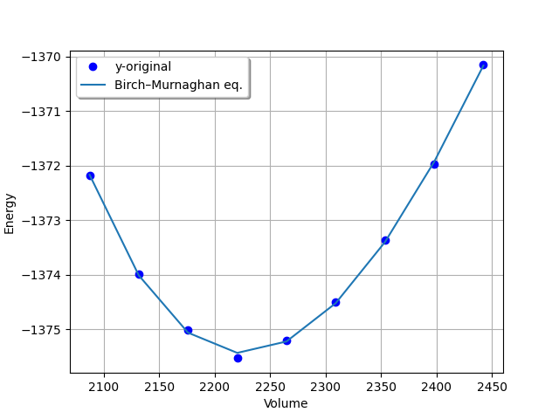
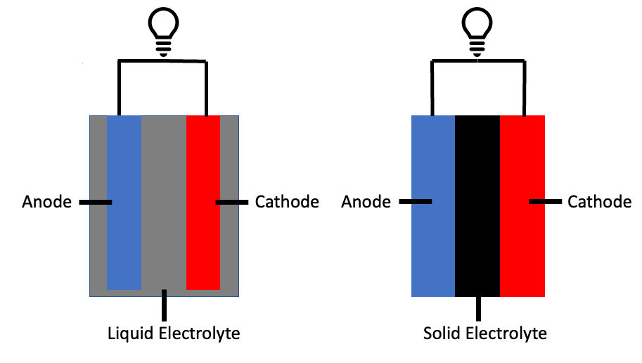
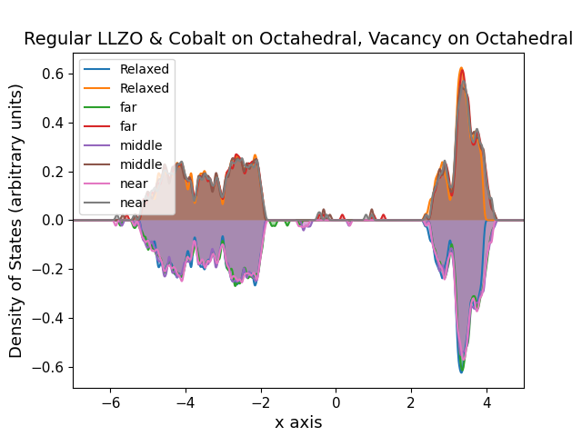
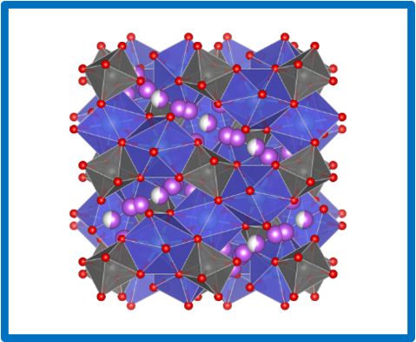
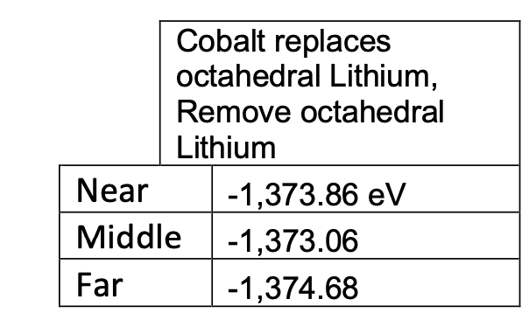
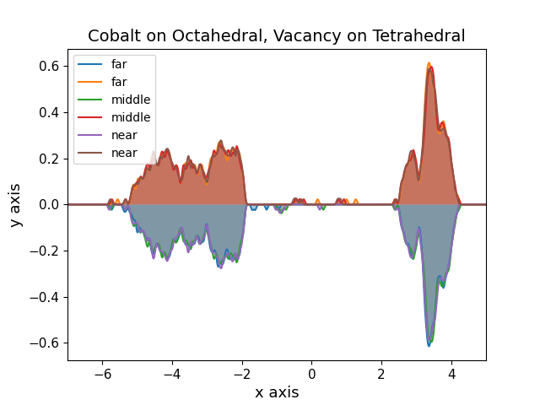
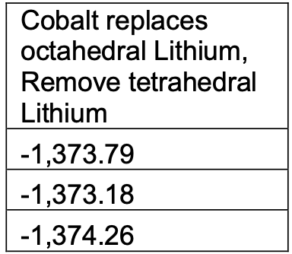
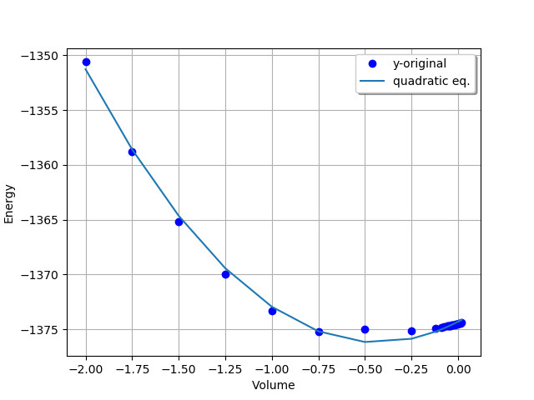
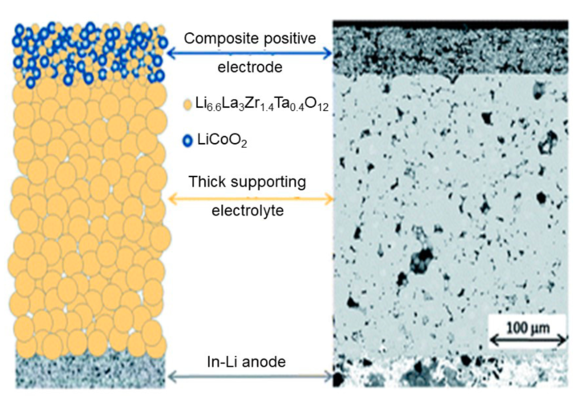

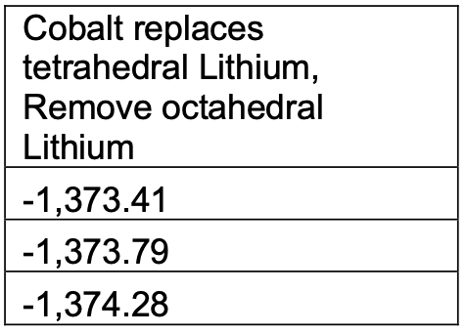


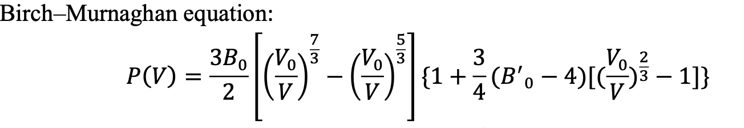
Ionic Transport Across Disordered Interfaces with Atomic-Scale Simulations
Elastic Properties
Bulk modulus of LLZO
To calculate the bulk modulus of the LLZO system we used the VASP program on multiple systems where the only parameter changed was the volume of the supercell. Allowing each system to relax gave us values that we could then fit a curve to. Fitting the data to The Birch–Murnaghan isothermal equation of state would return the bulk modulus value, 6.41371990e-01, in terms of eV per angstroms cubed.
This value could then be converted to 102.76 GPa and compared to the literature value of 112.4 Gpa [6], verifying that our calculations are not too far off.
Oskar K. Garcia, Kwangnam Kim, Liwen Wan, Nicole Adelstein
Department of Physics and Astronomy, & Department of Chemistry and Biochemistry
College of Science and Engineering
Quantum Simulations Group Lawrence Livermore National Laboratories
Motivation: Solid-Electrolytes
Electronic Properties
In solid state battery materials Li6La3Zr2O12 (LLZO) is one of the most conductive options available. If enough can be learned about this material, it may be possible to replace current liquid electrolyte batteries with a safer more energy dense alternative
Co doping creates defect states in the band gap, which will lead to discoloration of samples.
Figure 1. Liquid to Solid state battery comparison
Energy of Systems:
-Solid state batteries can outperform current batteries because:
They are more stable in extreme temperatures
They are more energy dense
-They fall behind because
They are not as conductive as liquid electrolytes
Density of States (arbitrary units)
Energy (eV)
C11 Elastic Tensor
To calculate the elastic tensors of the LLZO system we used the VASP program on multiple systems where the only parameter changed was the orientation of the supercell providing some twisting or shearing. Allowing each system to relax gave us values that we could then fit a curve to. Fitting the data to The quadratic equation would return the C11 elastic tensor value, 10.16289271e-01, in terms of eV per angstroms cubed.
This value could then be converted to 162.827491 GPa which can be compared to the literature value of 187.0 GPa [6], not exact but not too far either.
Figure 2. LLZO Unit Cell
\
Cobalt doping in LLZO is due to Co diffusing from the LiCoO2 cathode into the LLZO electrolyte. Experimental evidence shows a change in color when LLZO is synthesized with the LCO cathode, which we hypothesize is due to Co diffusion into LCO. Future studies will determine the effect of Co on Li diffusion in LLZO.
Note, Co is expensive and so cathodes without Co are preferred.
Density of States (arbitrary units)
Density of States (arbitrary units)
Energy (eV)
Methods
This project uses VASP to calculate the electronic structure due to Co doping and the elastic properties.
The Cobalt atoms are placed in either a tetrahedral or octahedral site formerly occupied by a Lithium and another Lithium is also removed from either a tetrahedral or octahedral site. This is done for Cobalt and Lithium vacancies at different distances from one another, the nearest two Cobalt and vacancies, the median in distance and the furthest in distance.
To calculate the elastic properties a few variations of each system are made, relaxed, and their energies are fit to the Birch-Murnaghan, quartic, or quadratic equations:
Density of States (arbitrary units)
Tensor parameter delta
Figure 5. Bulk Modulus and C11 Elastic Tensor graphs
Conclusions & Acknowledgements
I would like to thank the members of the Adelstein lab for their contributions to this project such as running MD and calculating diffusivity. This project was supported by grants from the NIH (Grant No.T34-GM008574) and NSF(Grant No. DMR-1710630).
[1] G. Kresse and J. Hafner, Phys. Rev. B 47 , 558 (1993); ibid. 49 , 14 251 (1994).
[2] G. Kresse and J. FurthmÃ¼ller, Comput. Mat. Sci. 6 , 15 (1996).
[3] G. Kresse and J. FurthmÃ¼ller, Phys. Rev. B 54 , 11 169 (1996).
[4] D. Holec, M. Friak J. Neugerbauer, P. Mayrhofer Phys Rev. B 85 (2012)
[5] M. Grimsditch, E. S. Zouboulis, A. Polian Journ. App. Sci. 76 832 (1998)
[6] Elastic properties of the solid electrolyte Li7La3Zr2O12 (LLZO). (n.d.). https://doi.org/10.1021/acs.chemmater.5b03854.s001
[7] Reddy, M. V., Julien, C. M., Mauger, A., & Zaghib, K. (2020). Sulfide and oxide inorganic solid electrolytes for all-solid-state Li Batteries: A Review. Nanomaterials, 10(8), 1606. https://doi.org/10.3390/nano10081606
Energy (eV)
Figure 3. Density of States Graphs and tables
Figure 3. Bulk Modulus fitting equation
Notes:
Manganese dioxide (MnO₂) is a promising material for electrochemical technologies due to its abundance and electrochemical versatility. In this study, we investigate the thermodynamic and kinetic properties of various MnO₂ polymorphs—specifically the α, β, γ, and δ crystal structures—through computational analysis. Our focus lies in determining how the elastic properties affect phase transformations. Leveraging code developed by our collaborators at livermore, we simulate phase transitions and energy landscapes between polymorphs. This computational insight is intended to guide experimental synthesis carried out by our team’s graduate researchers. Our hypothesis is that through this combined theoretical-experimental approach, we can control which crystal structure is present after synthesis or operation.

